Slide 1
PROBABILITY & STATISTICS
Chapter 11: Simple Linear Regression and Correlation
Learning objectives
Empirical Models
Simple Linear Regression
Correlation

Slide 2
Empirical Models
Empirical models
Many problems in engineering and science involve exploring the relationships between two or more variables.
Regression analysis is a statistical technique that is very useful for these types of problems.
For example, in a chemical process, suppose that the yield of the product is related to the process-operating temperature.
Regression analysis can be used to build a model to predict yield at a given temperature level.

Slide 3
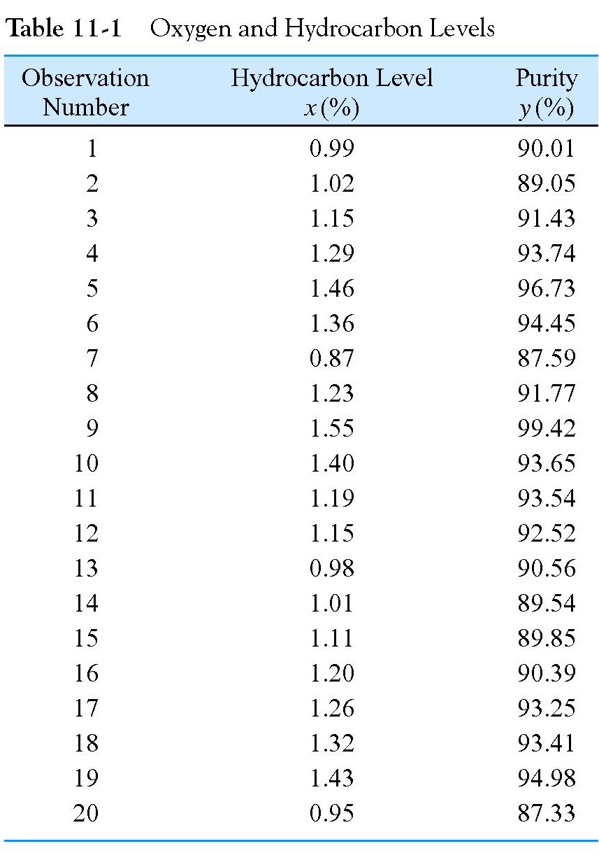
Empirical Models
Empirical models

Slide 4
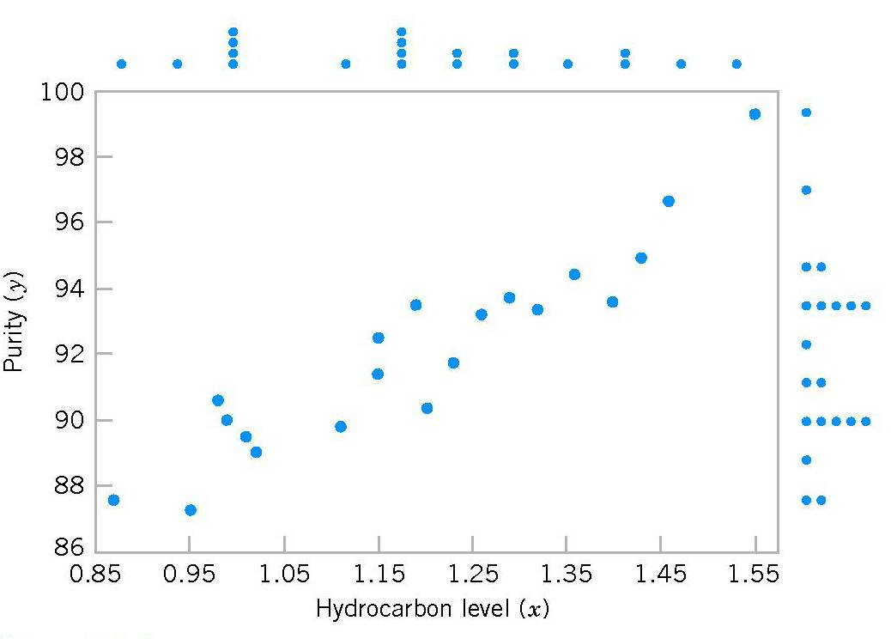
Empirical Models
Empirical models
Figure 11-1 Scatter Diagram of oxygen purity versus hydrocarbon level from Table 11-1.

Slide 5
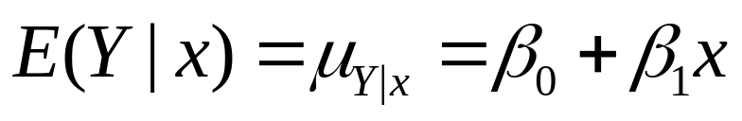
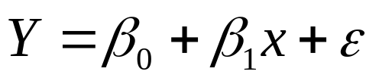
Empirical Models
Empirical models
Based on the scatter diagram, it is probably reasonable to assume that the mean of the random variable Y is related to x by the following straight-line relationship:
regression coefficients.
The simple linear regression model is given by
random error

Slide 6
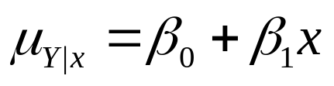
Empirical Models
Suppose that the mean and variance of ε are 0 and σ², respectively, then
Empirical models
The variance of Y given x is
The true regression model is a line of mean values:

Slide 7
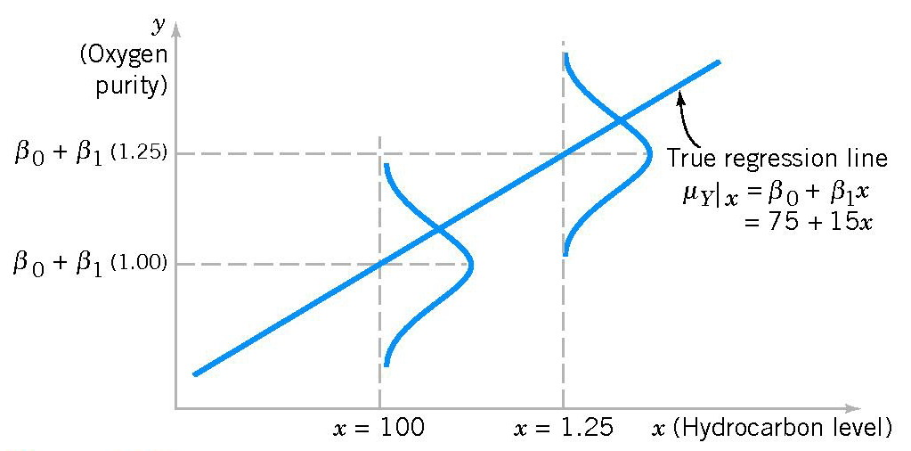
Empirical Models
Empirical models
Figure 11-2 The distribution of Y for a given value of x for the oxygen purity-hydrocarbon data.

Slide 8
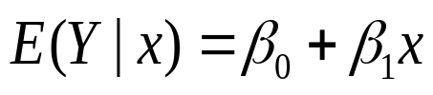
Simple Linear Regression
The case of simple linear regression considers a single regressor or predictor x and a dependent or response variable Y.
The expected value of Y at each level of x is a random variable:
Simple Linear Regression
We assume that each observation, Y, can be described by the model

Slide 9

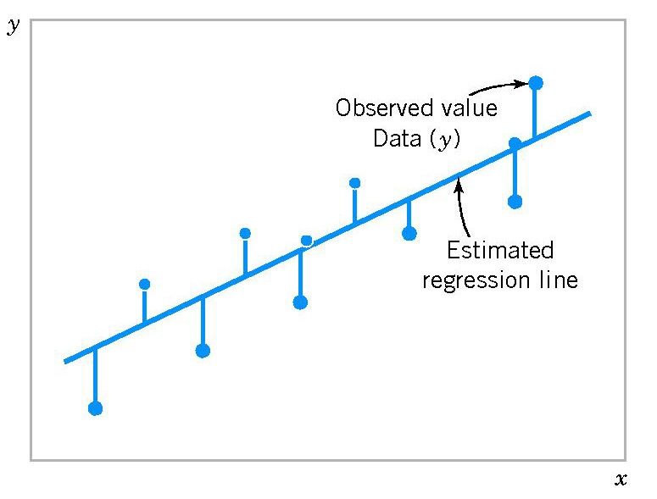
Simple Linear Regression
Suppose that we have n pairs of observations (x₁, y₁), (x₂, y₂), …, (x_{n}, y_{n}):
Simple Linear Regression
Figure 11-3 Deviations of the data from the estimated regression model.

Slide 10
Simple Linear Regression
The method of least squares is used to estimate the parameters, β₀ and β₁ by minimizing the sum of the squares of the vertical deviations in Figure 11-3.
Simple Linear Regression
Figure 11-3 Deviations of the data from the estimated regression model.

Slide 11
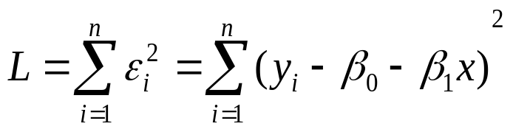
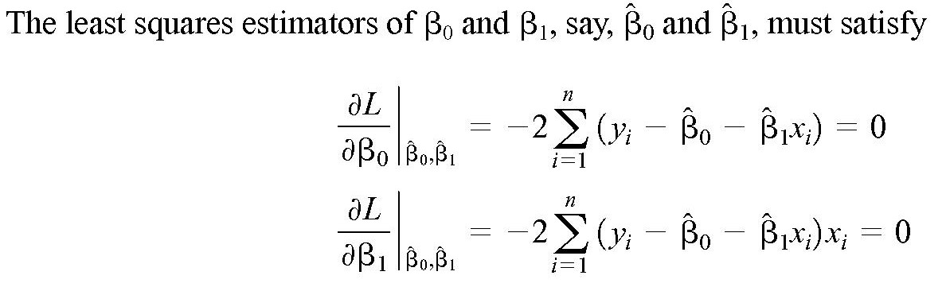
Simple Linear Regression
The sum of the squares of the deviations of the observations from the true regression line is
Simple Linear Regression

Slide 12
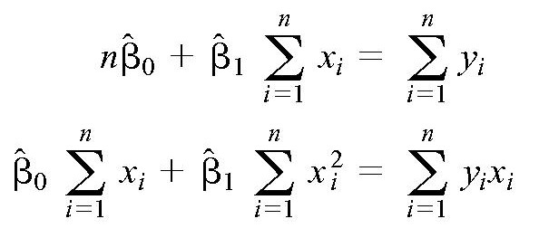
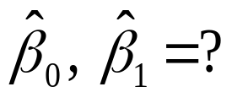
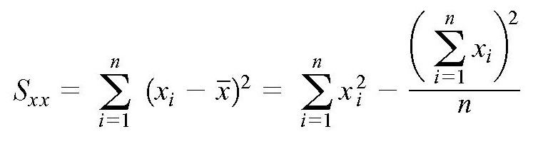
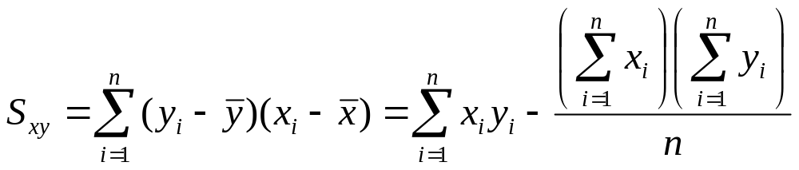
Simple Linear Regression
Simplifying these two equations yields
Simple Linear Regression
Notation

Slide 13
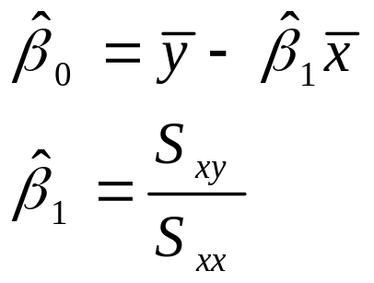
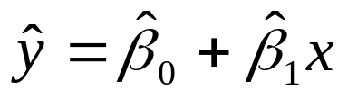
Simple Linear Regression
Theorem
The least squares estimates of the intercept and slope in the simple linear regression model are
Estimated regression line is
Simple Linear Regression

Slide 14
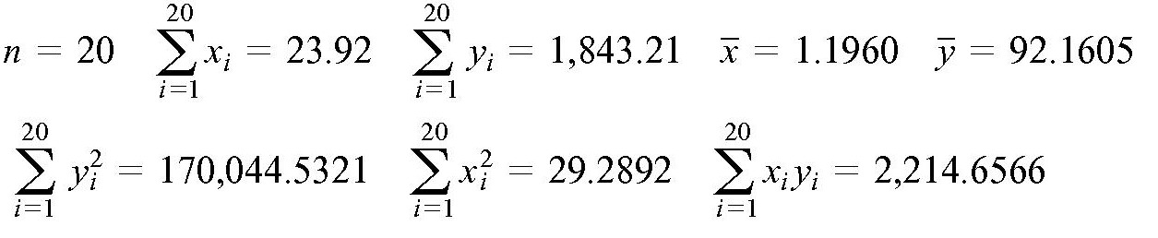
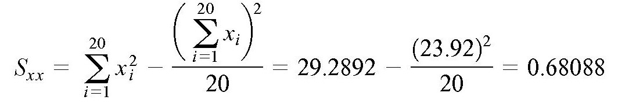
Simple Linear Regression
Example
We will fit a simple linear regression model to the oxygen purity data in Table 11-1. The following quantities may be computed:
Simple Linear Regression

Slide 15
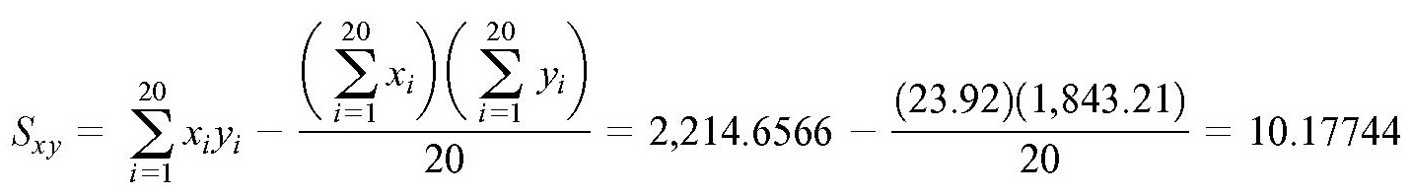
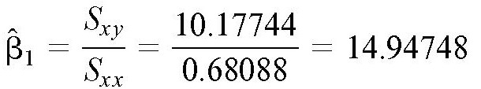
Simple Linear Regression
Simple Linear Regression
Therefore, the least squares estimates of the slope and intercept are

Slide 16

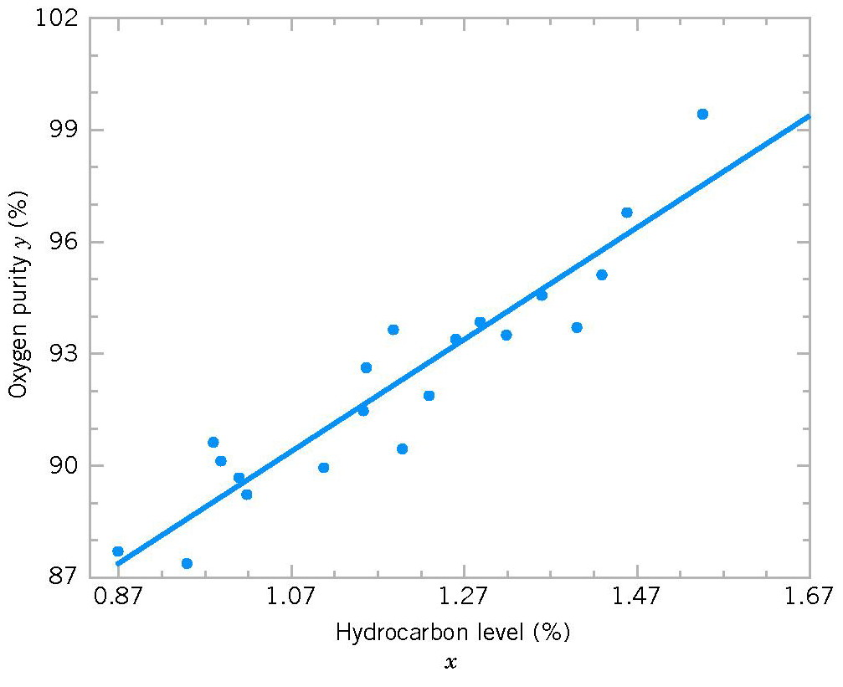
Simple Linear Regression
The fitted simple linear regression model is
Simple Linear Regression

Slide 17
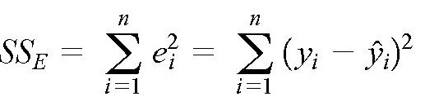
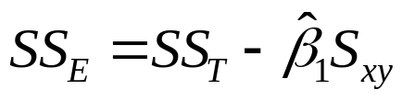
Simple Linear Regression Estimating σ²
Estimating σ²
The error sum of squares is
Estimating σ²
We have
E(SS_{E}) = (n – 2)σ².

Slide 18
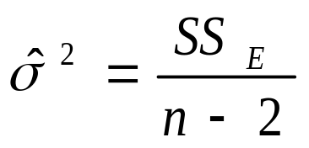

Simple Linear Regression Estimating σ²
Estimating σ²
Theorem
An unbiased estimator of σ² is
where
Estimating σ²
Standard error
Standard error

Slide 19
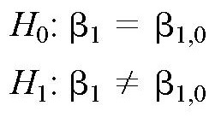
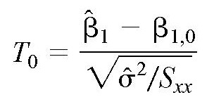
Hypothesis Tests in Simple Linear Regression
Test on the β₁
Hypothesis
tests
Test statistic
has the t distribution with n - 2 degrees of freedom.
If |t₀| > t_{α/2, n-2} : reject H₀
If |t₀| < t_{α/2, n-2} : fail to reject H₀

Slide 20
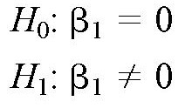
Hypothesis Tests in Simple Linear Regression
Test on the β₁
An important special case
Hypothesis
tests
These hypotheses relate to the significance of regression.
Failure to reject H₀ is equivalent to concluding that there is no linear relationship between x and Y.

Slide 21
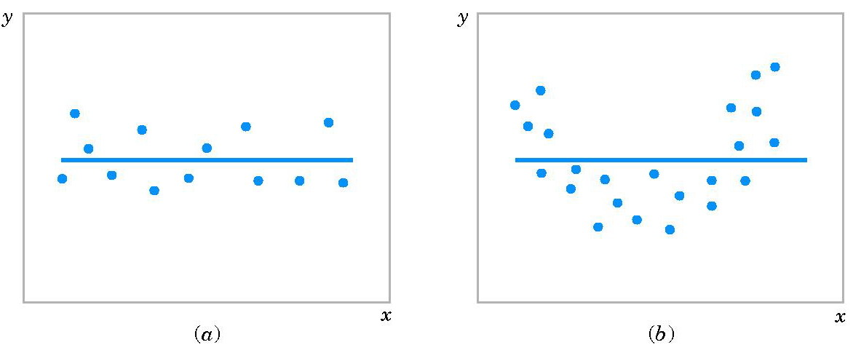
Hypothesis Tests in Simple Linear Regression
Test on the β₁
Hypothesis
tests
Figure 11-5 The hypothesis H₀: β₁ = 0 is not rejected.

Slide 22
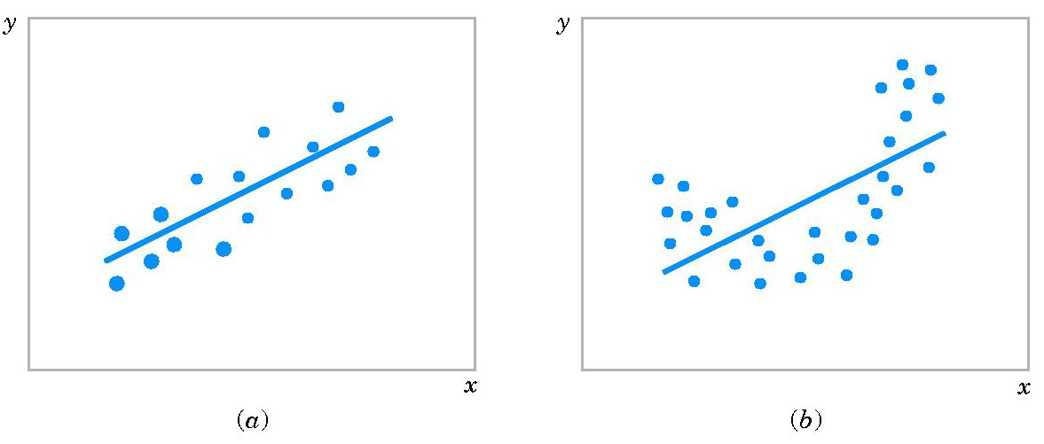
Hypothesis Tests in Simple Linear Regression
Test on the β₁
Hypothesis
tests
Figure 11-6 The hypothesis H₀: β₁ = 0 is rejected.

Slide 23
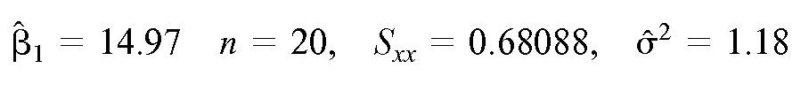
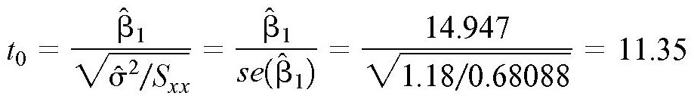
Hypothesis Tests in Simple Linear Regression
Example
We will test for significance of regression using the model for the oxygen purity data from Table 11-1. The hypotheses are
and we will use α = 0.01.
Hypothesis
tests
Recall
Test statistic

Slide 24
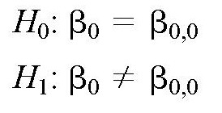
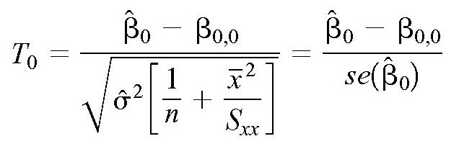
Hypothesis Tests in Simple Linear Regression
t_{α/2, n-2} = t_{0.005,18} = 2.88 < |t₀|
Reject H₀
If |t₀| > t_{α/2, n-2} : reject H₀
If |t₀| < t_{α/2, n-2} : fail to reject H₀
Test on the β₀
Hypothesis
tests
Test statistic

Slide 25
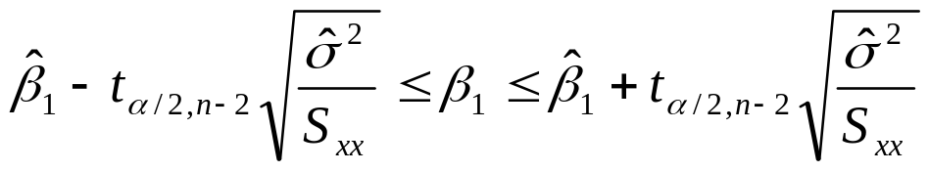
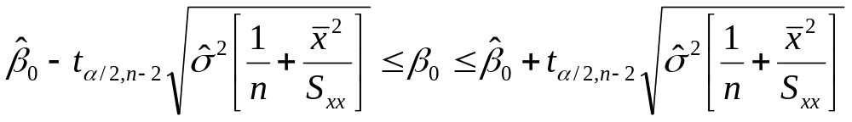
Confidence Intervals
Confidence Intervals on the Slope and Intercept
Under the assumption that the observations are normally and independently distributed, a 100(1-α)% confidence interval on the slope β₁ in simple linear regression is
Similarly, a 100(1-α)% confidence interval on the intercept β₀ is
Confidence
intervals

Slide 26
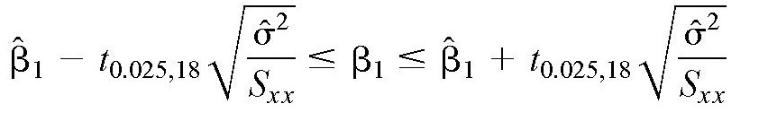
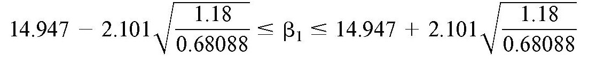

Confidence Intervals
Example
We will find a 95% confidence interval on the slope of the regression line using the data in Table 11-1.
Recall
CI 95% for β₁ :
Confidence
intervals

Slide 27

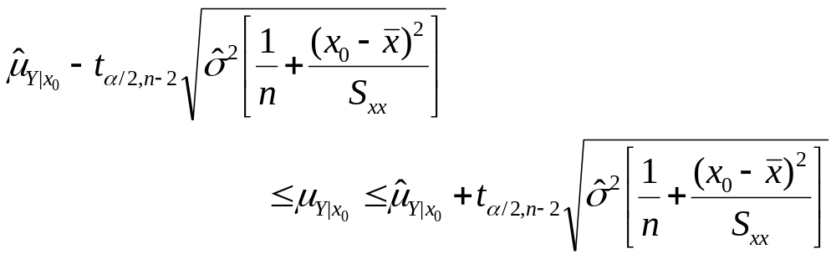
Confidence Intervals
Confidence Interval on the Mean Response
A 100(1-α)% confidence interval about the mean response at the value of x=x₀ is given by
Confidence
intervals

Slide 28



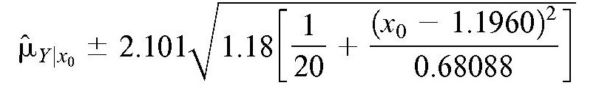
Confidence Intervals
Example
We will find a 95% confidence interval about the mean response for the data in Table 11-1.
The fitted model is
If we are interested in predicting mean oxygen purity when x₀ = 100% then
Confidence
intervals
CI 95% on

Slide 29
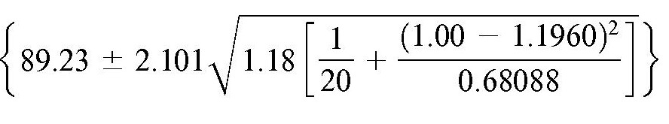

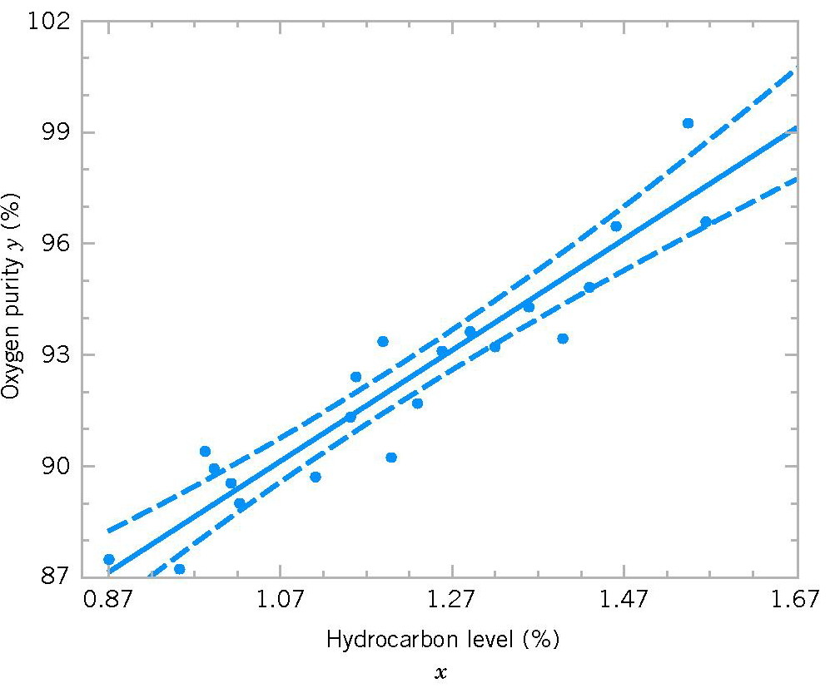
Confidence Intervals
Confidence
intervals
Scatter diagram of oxygen purity with fitted regression line and 95% confidence limits on μ_{Y|x0}.

Slide 30
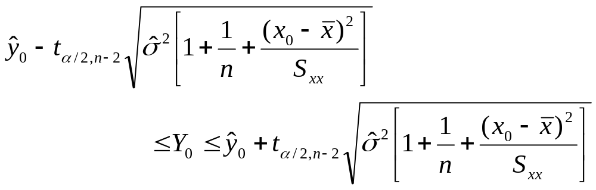

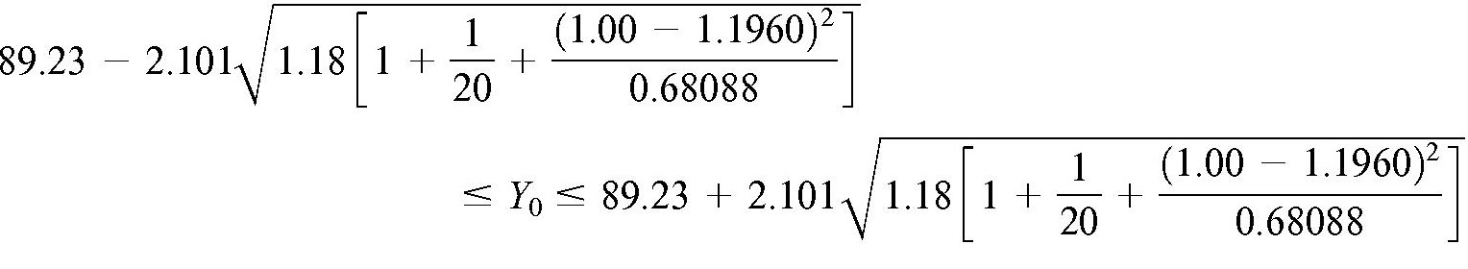
Prediction of New Observations
A 100(1-α)% prediction interval on a future observation Y₀ at the value x₀ is given by
Prediction
Return to Table 11.1, confidence interval 95% on Y₀ at x₀ = 100%

Slide 31
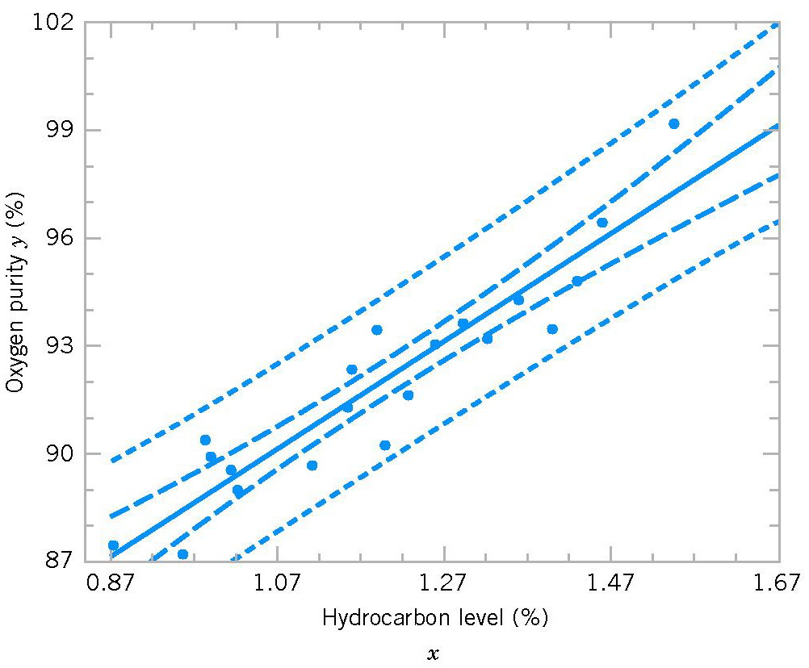
Prediction of New Observations
Prediction
Scatter diagram of oxygen purity data from Table 11.1 with fitted regression line, 95% prediction limits, and 95% confidence limits on μ_{Y|x0}.

Slide 32
Adequacy of the Regression Model
Fitting a regression model requires several assumptions.
  Errors are uncorrelated random variables with mean zero;
  Errors have constant variance; and,
  Errors be normally distributed.
The analyst should always consider the validity of these assumptions to be doubtful and conduct analyses to examine the adequacy of the model
Adequacy

Slide 33
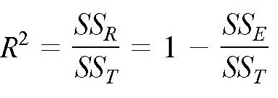
Adequacy of the Regression Model
Coefficient of Determination (R²)
The quantity
is called the coefficient of determination and is often used to judge the adequacy of a regression model.
Adequacy
0 ≤ R² ≤ 1;
We often refer to R² as the amount of variability in the data explained or accounted for by the regression model.

Slide 34
Adequacy of the Regression Model
Example
For the oxygen purity regression model,
R² = SS_{R}/SS_{T}
= 152.13/173.38
= 0.877
Thus, the model accounts for 87.7% of the variability in the data.
Adequacy

Slide 35
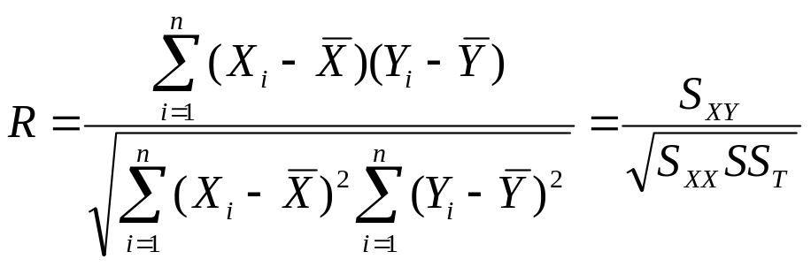
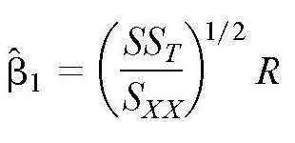
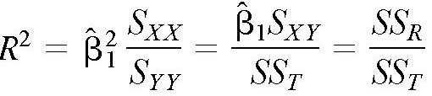
Correlation
Definition
The sample correlation coefficient
Note that
Correlation
We may also write:

Slide 36
Correlation
Properties of the Linear Correlation Coefficient r
1. –1 ≤ r ≤ 1
2. The value of r does not change if all values of either variable are converted to a different scale.
3. The value of r is not affected by the choice of x and y. Interchange all x- and y-values and the value of r will not change.
4. r measures strength of a linear relationship.
Correlation

Slide 37

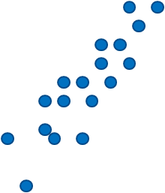
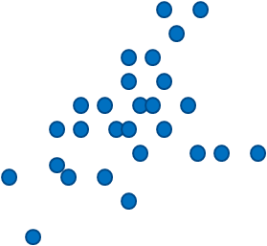

Correlation
y
y
r = −0.91
r = 0.88
x
x
Strong negative correlation
Strong positive correlation
y
y
r = 0.42
r = 0.07
Correlation
x
x
Weak positive correlation
Nonlinear Correlation

Slide 38


Correlation
Test on the ρ
Test statistic
has the t distribution with n - 2 degrees of freedom.
If |t₀| > t_{α/2, n-2} : reject H₀
If |t₀| < t_{α/2, n-2} : fail to reject H₀
Correlation

Slide 39



Correlation
Test on the ρ
Test statistic
If |t₀| > z_{α/2} : reject H₀
If |t₀| < z_{α/2} : fail to reject H₀
Correlation

Slide 40
SUMMARY
We have studied:
1. Empirical Models
2. Simple Linear Regression
3. Correlation
Homework: Read slides of the next lecture.
Summary

